Slide 1
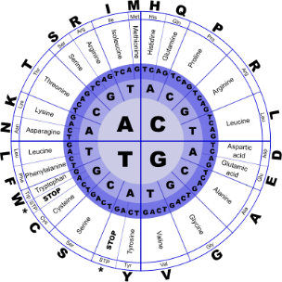
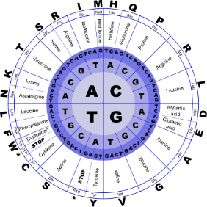


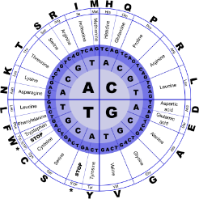
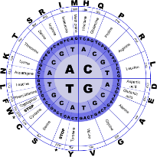
Fundamentals of Programming II
Objects

Slide 2
Abstract Data Types (ADT)
An abstract data type (ADT) is a
mathematical model for data types
where a data type is defined by its behavior (semantics) from the point of view of a user of the data,
specifically in terms of possible values,
possible operations on data of this type,
and the behavior of these operations

Slide 3
Abstract Data Types (ADT)
Programmer-created data types that specify
legal values that can be stored
operations that can be done on the values

Slide 4
Abstract Data Types (ADT)
The user of an ADT does not need to know any implementation details
how the data is stored
or
how the operations on it are carried out

Slide 5
Abstraction in Software Development
Abstraction allows a programmer
- to design a solution to a problem
- to use data items without concern for how the data items are implemented

Slide 6
Abstraction in Software Development
This has already been encountered
To use the pow function, you need to know what inputs it expects and what kind of results it produces
You do not need to know how it works

Slide 7
Abstraction and Data Types
Abstraction: a definition that captures general characteristics without details
ex: An abstract triangle is a 3-sided polygon. A specific triangle may be scalene, isosceles, or equilateral
Data Type: defines the kind of values that can be stored and the operations that can be performed on it

Slide 8
Object-Oriented Programming
Procedural programming uses variables to store data, and focuses on the processes/ functions that occur in a program. Data and functions are separate and distinct.
Object-oriented programming is based on objects that encapsulate the data and the functions that operate on it.

Slide 9
Object-Oriented Programming
object: software entity that combines data and functions that act on the data in a single unit
attributes: the data items of an object, stored in member variables
member functions (methods): procedures/ functions that act on the attributes of the class

Slide 10
Object-Oriented Programming
data hiding: restricting access to certain members of an object. The intent is to allow only member functions to directly access and modify the object’s data
encapsulation: the bundling of an object’s data and procedures into a single entity

Slide 11
Why Hide Data?
Protection – Member functions provide a layer of protection against inadvertent or deliberate data corruption
Need-to-know – A programmer can use the data via the provided member functions. As long as the member functions return correct information, the programmer needn’t worry about implementation details.

Slide 12
Introduction to Classes
Class: a programmer-defined data type used to define objects
It is a pattern for creating objects
ex:
string fName, lName;
creates two objects of the string class

Slide 13
Introduction to Classes
A class is
an expanded concept of a data structure: instead of holding only data,
it can hold both data and functions.

Slide 14
Introduction to Classes
A class is
used to specify the form of an object and it combines data representation and methods for manipulating that data into one neat package.
The data and functions within a class are called members of the class.

Slide 15
Introduction to Classes
Classes are generally declared using the keyword class, with the following format:
class ClassName { access_specifier_1: member1; access_specifier_2: member2; ... };
class_name is a valid identifier for the class
object_names is an optional list of names for objects of this class.
The body of the declaration can contain members, that can be either data or function declarations, and optionally access specifiers.

Slide 16
Introduction to Classes
Class declaration format
class ClassName
{
declaration;
declaration;
};
Notice the required ;

Slide 17
Access Specifiers
Used to control access to members of the class.
Each member is declared to be either
public: can be accessed by functions outside of the class
or
private: can only be called by or accessed by functions that are members of the class

Slide 18
Access Specifiers
All is very similar to the declaration on data structures, except that we can now include also functions and members, but also this new thing called access specifier.
An access specifier is one of the following three keywords: private, public or protected.
These specifiers modify the access rights that the members following them acquire:

Slide 19
Access Specifiers
private members of a class are accessible only from within other members of the same class or from their friends.

Slide 20
Access Specifiers
protected members are accessible from members of their same class and from their friends, but also from members of their derived classes.

Slide 21
Access Specifiers
public members are accessible from anywhere where the object is visible.

Slide 22
Access Specifiers
By default, all members of a class declared with the class keyword have private access for all its members.
Therefore, any member that is declared before one other class specifier automatically has private access.

Slide 23
Access Specifiers
class Square
{
private:
int side;
public:
void setSide(int s)
{ side = s; }
int getSide()
{ return side; }
};
Access specifiers

Slide 24
Access Specifiers
Can be listed in any order in a class
Can appear multiple times in a class
If not specified, the default is private

Slide 25
Creating and Using Objects
An object is an instance of a class
It is defined just like other variables
Square sq1, sq2;
It can access members using dot operator
sq1.setSide(5);
cout << sq1.getSide();
Example: class 0, 0a,1

Slide 26
Defining Member Functions
Member functions are part of a class declaration
Can place entire function definition inside the class declaration
or
Can place just the prototype inside the class declaration and write the function definition after the class

Slide 27
Defining Member Functions
Member functions defined inside the class declaration are called inline functions
Only very short functions, like the one below, should be inline functions
int getSide()
{ return side; }

Slide 28
Inline Member Function Example
class Square
{
private:
int side;
public:
void setSide(int s)
{ side = s; }
int getSide()
{ return side; }
};
inline functions

Slide 29
Inline Member Function Example
Put a function prototype in the class declaration
In the function definition, precede the function name with the class name and scope resolution operator (::)
int Square::getSide()
{
return side;
}

Slide 30
Private Member Functions
A private member function can only be called by another member function of the same class
It is used for internal processing by the class, not for use outside of the class

Slide 31
Private Member Functions
Class member functions
A member function of a class is a function that has its definition or its prototype within the class definition like any other variable.
Example: class 2

Slide 32
Private Member Functions
Class access modifiers
A class member can be defined as public, private or protected. By default members would be assumed as private
Example: class 3
class 4
class 5

Slide 33
Constructors
A constructor is a member function that is often used to initialize data members of a class
Is called automatically when an object of the class is created
It must be a public member function
It must be named the same as the class
It must have no return type

Slide 34
Constructors
Inline: class Square { . . . public: Square(int s) { side = s; } . . . }; | Declaration outside the class: Square(int); //prototype //in class Square::Square(int s) { side = s; }

Slide 35
Overloading Constructors
A class can have more than 1 constructor
Overloaded constructors in a class must have different parameter lists
Square();
Square(int);

Slide 36
The Default Constructor
Constructors can have any number of parameters, including none
A default constructor is one that takes no arguments either due to
No parameters or
All parameters have default values
If a class has any programmer-defined constructors, it must have a programmer- defined default constructor

Slide 37
The Default Constructor
class Square
{
private:
int side;
public:
Square() // default
{ side = 1; } // constructor
// Other member
// functions go here
};
Has no
parameters

Slide 38
The Default Constructor
class Square
{
private:
int side;
public:
Square(int s = 1) // default
{ side = s; } // constructor
// Other member
// functions go here
};
Has parameter
but it has a default value

Slide 39
Invoking a Constructor
To create an object using the default constructor, use no argument list and no ()
Square square1;
To create an object using a constructor that has parameters, include an argument list
Square square1(8);
Every time an instance of a class is created the constructor method is called. The constructor has the same name as the class and it doesn't return any type, while the destructor's name it's defined in the same way, but with a '~' in front:

Slide 40
Destructors
Is a public member function automatically called when an object is destroyed
The destructor name is ~className, e.g., ~Square
It has no return type
It takes no arguments
Only 1 destructor is allowed per class
(i.e., it cannot be overloaded)

Slide 41
Friend Functions
A friend function is permitted full access to private and protected members of a class.

Slide 42
Inline Functions
With an inline function, the compiler tries to expand the code in the body of the function in place of a call to the function.

Slide 43
Passing Objects to Functions
A class object can be passed as an argument to a function
When passed by value, function makes a local copy of object. Original object in calling environment is unaffected by actions in function
When passed by reference, function can use ‘set’ functions to modify the object.

Slide 44
Passing Objects to Functions
Using a value parameter for an object can slow down a program and waste space
Using a reference parameter speeds up program, but allows the function to modify data in the parameter

Slide 45
Passing Objects to Functions
To save space and time, while protecting parameter data that should not be changed, use a const reference parameter
void showData(const Square &s)
// header
In order to for the showData function to call Square member functions, those functions must use const in their prototype and header:
int Square::getSide() const;

Slide 46
Returning an Object from a Function
A function can return an object
Square initSquare(); // prototype
s1 = initSquare(); // call
The function must define a object
for internal use
to use with return statement

Slide 47
Returning an Object from a Function
Square initSquare()
{
Square s; // local variable
int inputSize;
cout << "Enter the length of side: ";
cin >> inputSize;
s.setSide(inputSize);
return s;
}

